Slide 1
Onsite Tutorial
Hibernia College
Saturday 9th February 2013

Slide 2
Tutorial
Today’s Class
Part 1 Graph Theory
Part 2 Digraphs and Relations
Part 3 Overview of previous material

Slide 3
Tutorial
Part 1 : Graph Theory
Important Terminology
Vertex / Vertices
Edges
Incidence
Adjacency
Simple Graphs
Connected Graphs
Degree
Parallel Edges
Loops
Isolated Vertex

Slide 4
Tutorial
Part 1 : Graph Theory
Degree Sequence of a graph
Computing the number of edges of a graph

Slide 5
Tutorial
Part 1 : Graph Theory
Special graphs
n-regular graphs
Complete graphs (K-graphs)

Slide 6
Tutorial
More terminology
Cycles (also known as trails and tours)
Paths
(Remark: Important definitions for more advanced algorithms, such as Travelling Salesman Problem and Chinese Postman Problem)

Slide 7
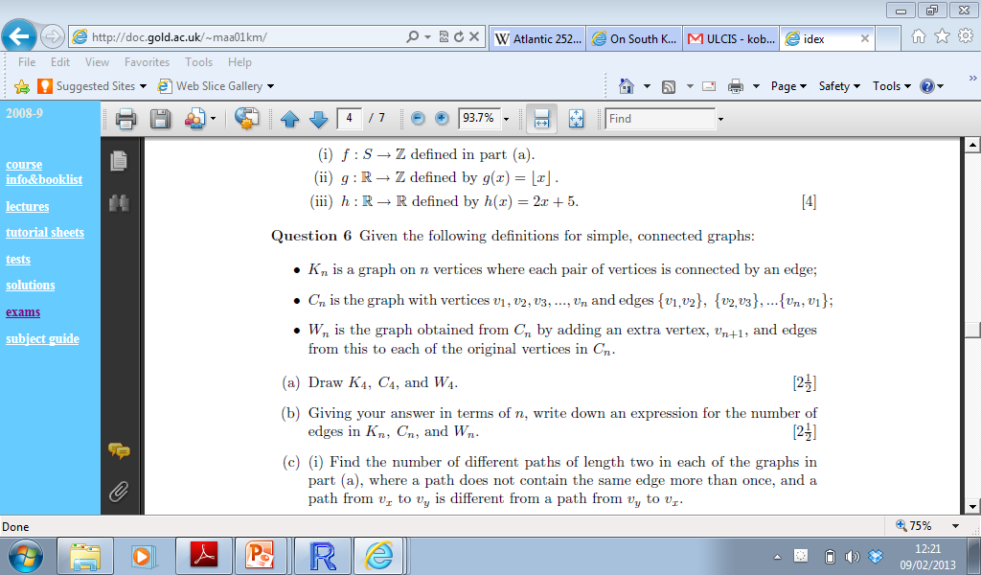
2003 Question 6

Slide 8
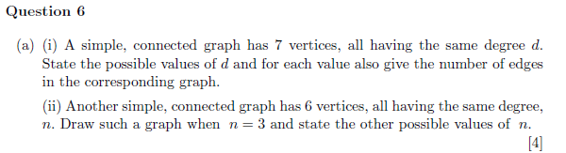
2006 Question 6

Slide 9
Tutorial
Isomorphism
Graphs that appear different are isomorphic if, in fact, they have same mathematical structure.
Mathematical structure of a graph can be considered as
Adjacency Lists
Adjacency Matrices

Slide 10
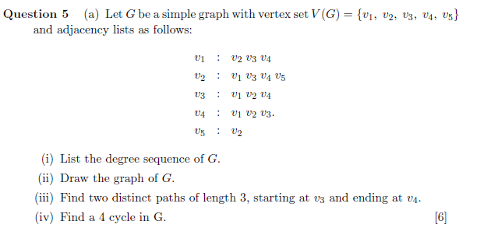
2003 Question 5

Slide 11
Digraphs
Directed Graphs
Adjacency Matrix and Adjacency Lists
Indegree and Outdegree of a vertex

Slide 12
Relations
Relations
Reflexive xRx?
Symmetric if xRy then yRx?
Transitive if xRy and yRz then yRz?

Slide 13
Relations
Consider the children of Emer and Finbar
Ann, Barry, Ciara and Dermot
Suppose the relation we are interested is “is the brother of”
dRc : Dermot is the brother of Ciara
bRd : Barry is the brother of Dermot

Slide 14
Relations
(Ciara, Dermot, Emer and Finbar)
Is this relation
Reflexive
Symmetric
Transitive

Slide 15
Relations
Suppose the relation is defined as
“ is the sibling of “
“ has the same parents as”

Slide 16
Relations
Transitive
A, B and C live in a row of three houses
A and B are next door neighbours (symm)
B and C are next door neighbours (symm)
Not transitive. A and C don’t live beside each other.

Slide 17
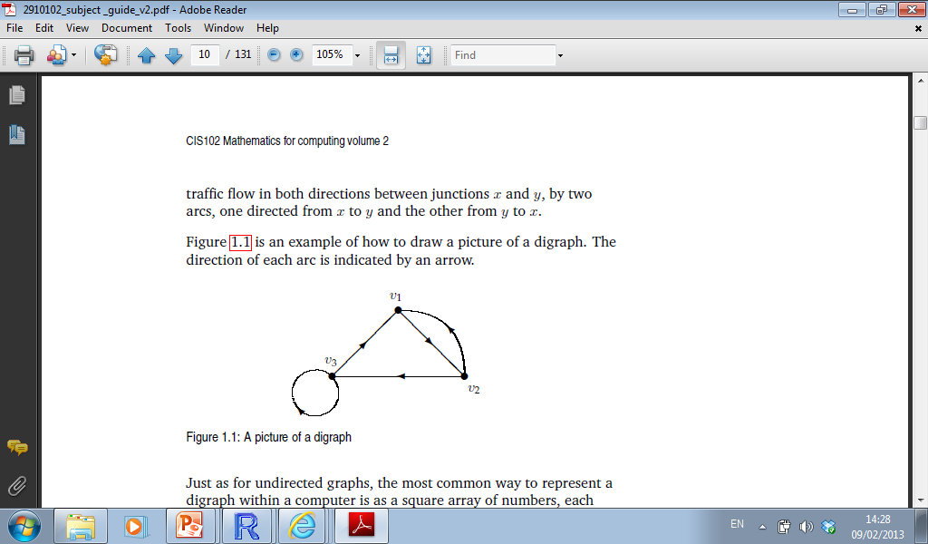
Digraphs and Relations

Slide 18
Relations
Equivalence Relations: A relation that is reflexive, symmetric and transitive.
Equivalence Classes

Slide 19
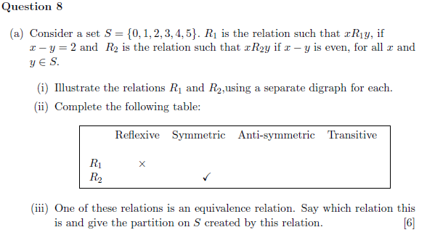
Relations

Slide 20
Cartesian Relations
Every possible ordered pairing of elements of two sets

